Slide 1
Patch Descriptors
CSE P 576
Larry Zitnick (larryz@microsoft.com)
Many slides courtesy of Steve Seitz

Slide 2
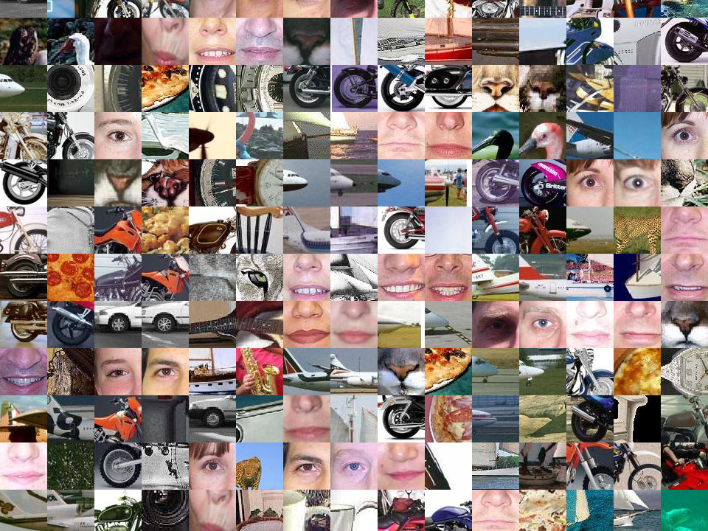
How do we describe an image patch?

Slide 3
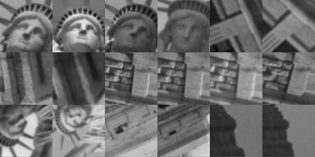
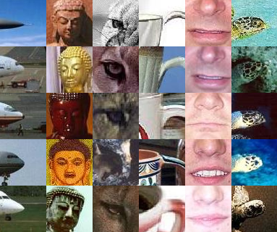
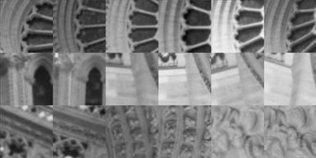
How do we describe an image patch?
Patches with similar content should have similar descriptors.

Slide 4
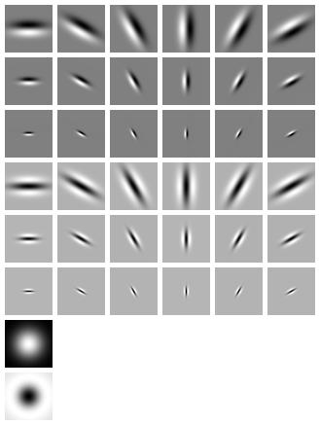
What do human use?
Gabor filters…
… and many other things.

Slide 6
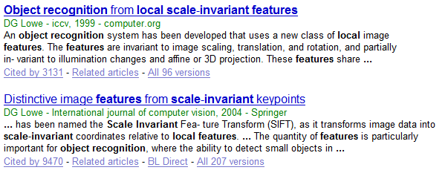
Encoding the gradients
Poster

Slide 7

Scale Invariant Feature Transform
Basic idea:
Take 16x16 square window around detected feature
Compute gradient orientation for each pixel
Create histogram over edge orientations weighted by magnitude
0
2π
angle histogram
Adapted from slide by David Lowe

Slide 8
SIFT descriptor
Full version
Divide the 16x16 window into a 4x4 grid of cells (2x2 case shown below)
Compute an orientation histogram for each cell
16 cells * 8 orientations = 128 dimensional descriptor
Adapted from slide by David Lowe

Slide 9
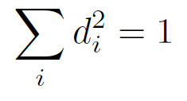
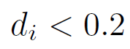
SIFT descriptor
Full version
Divide the 16x16 window into a 4x4 grid of cells (2x2 case shown below)
Compute an orientation histogram for each cell
16 cells * 8 orientations = 128 dimensional descriptor
Threshold normalize the descriptor:
such that:
Why?
0.2
Adapted from slide by David Lowe

Slide 10
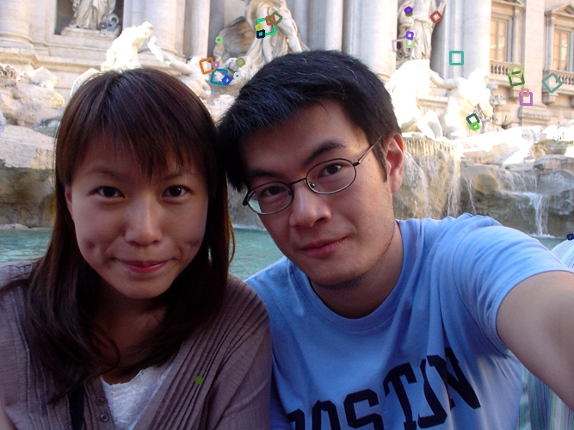
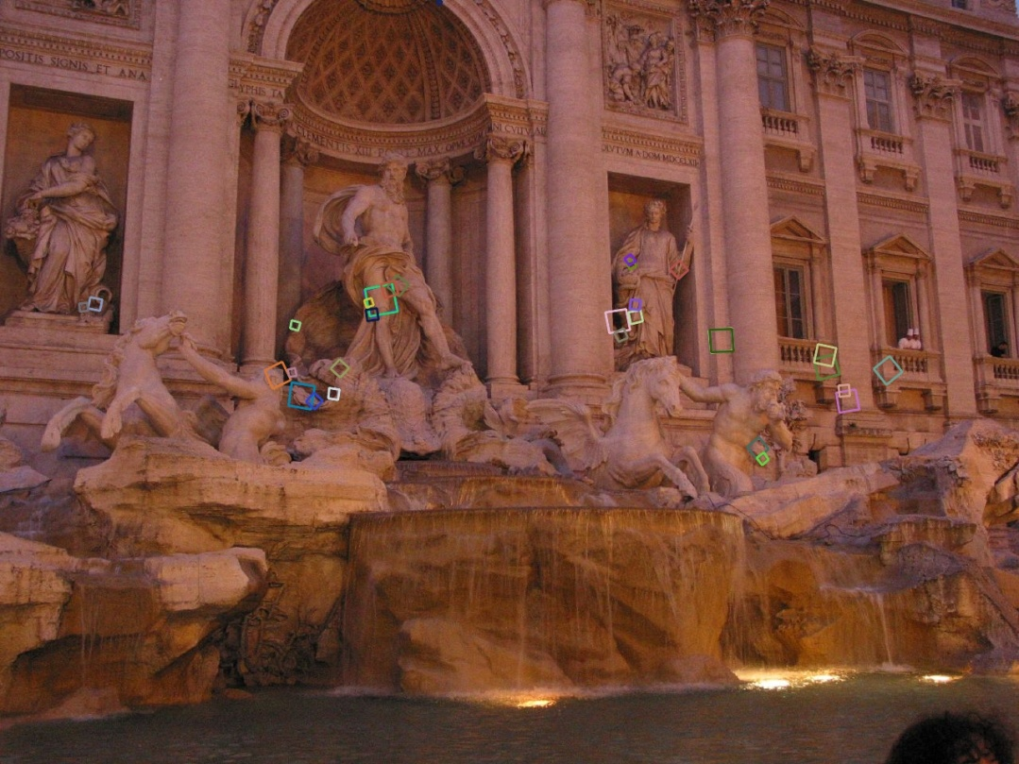
Properties of SIFT
Extraordinarily robust matching technique
Can handle changes in viewpoint
Up to about 30 degree out of plane rotation
Can handle significant changes in illumination
Sometimes even day vs. night (below)
Fast and efficient—can run in real time
Lots of code available
http://people.csail.mit.edu/albert/ladypack/wiki/index.php/Known_implementations_of_SIFT

Slide 11
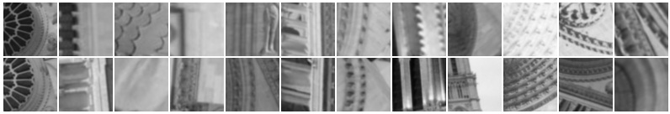
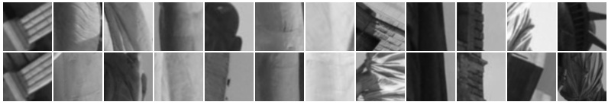
When does SIFT fail?
Patches SIFT thought were the same but aren’t:

Slide 12
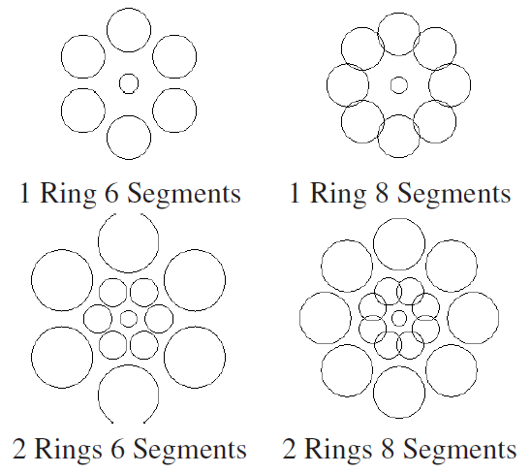
Other methods: Daisy
Circular gradient binning
SIFT
Daisy
Picking the best DAISY, S. Winder, G. Hua, M. Brown, CVPR 09

Slide 13
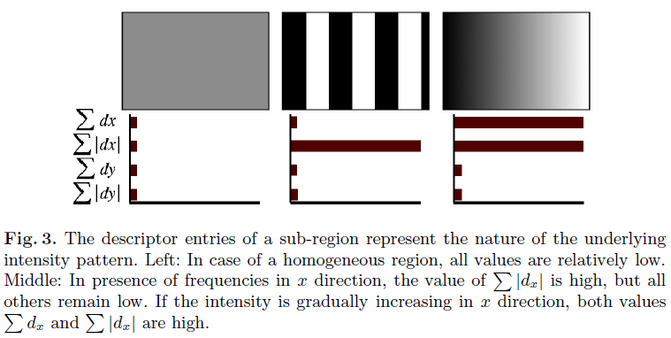
Other methods: SURF
For computational efficiency only compute gradient histogram with 4 bins:
SURF: Speeded Up Robust Features
Herbert Bay, Tinne Tuytelaars, and Luc Van Gool, ECCV 2006

Slide 14
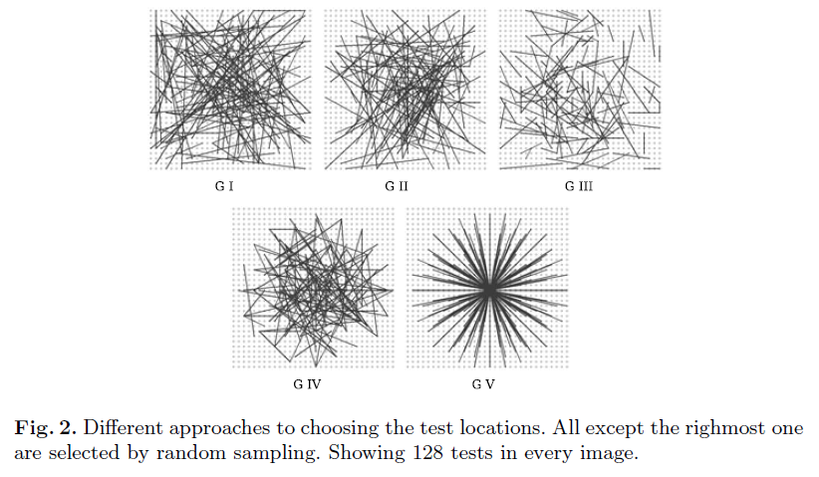
Other methods: BRIEF
Randomly sample pair of pixels a and b.
1 if a > b, else 0. Store binary vector.
Daisy
BRIEF: binary robust independent elementary features, Calonder, V Lepetit, C Strecha, ECCV 2010

Slide 15
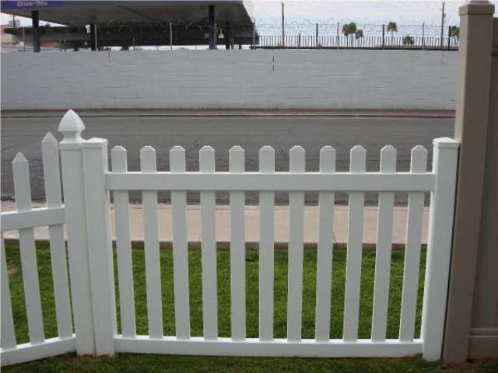
Feature distance
How to define the difference between two features f₁, f₂?
Simple approach is SSD(f₁, f₂)
sum of square differences between entries of the two descriptors
can give good scores to very ambiguous (bad) matches
f₁
f₂
I₁
I₂

Slide 16
Feature distance
How to define the difference between two features f₁, f₂?
Better approach: ratio distance = SSD(f₁, f₂) / SSD(f₁, f₂’)
f₂ is best SSD match to f₁ in I₂
f₂’ is 2nd best SSD match to f₁ in I₂
gives large values (~1) for ambiguous matches
f₁
f₂'
f₂
I₁
I₂

Slide 17
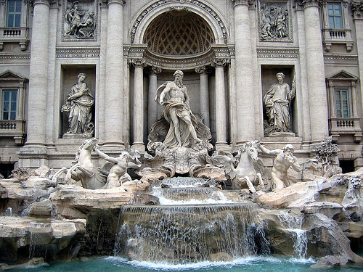
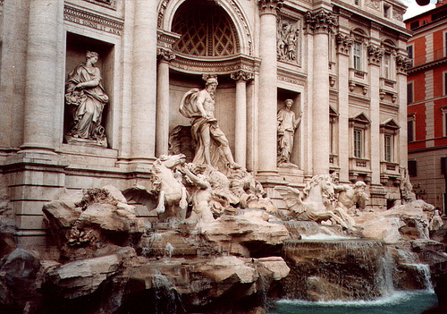
Eliminating bad matches
50
true match
75
200
false match
feature distance
Throw out features with distance > threshold
How to choose the threshold?

Slide 18
True/false positives
50
true match
75
200
false match
feature distance
The distance threshold affects performance
True positives = # of detected matches that are correct
Suppose we want to maximize these—how to choose threshold?
False positives = # of detected matches that are incorrect
Suppose we want to minimize these—how to choose threshold?

Slide 19
Evaluating the results
How can we measure the performance of a feature matcher?
1
the matcher correctly found a match
0.7
true positive rate
# true positives matched
# true positives
features that really do have a match
0
1
false positive rate
0.1
the matcher said yes when the right answer was no
# false positives matched
# true negatives
features that really don’t have a match

Slide 20
Evaluating the results
How can we measure the performance of a feature matcher?
ROC curve (“Receiver Operator Characteristic”)
1
0.7
true positive rate
# true positives matched
# true positives
0
1
false positive rate
0.1
# false positives matched
# true negatives
ROC Curves
Generated by counting # current/incorrect matches, for different threholds
Want to maximize area under the curve (AUC)
Useful for comparing different feature matching methods
For more info: http://en.wikipedia.org/wiki/Receiver_operating_characteristic

Slide 21
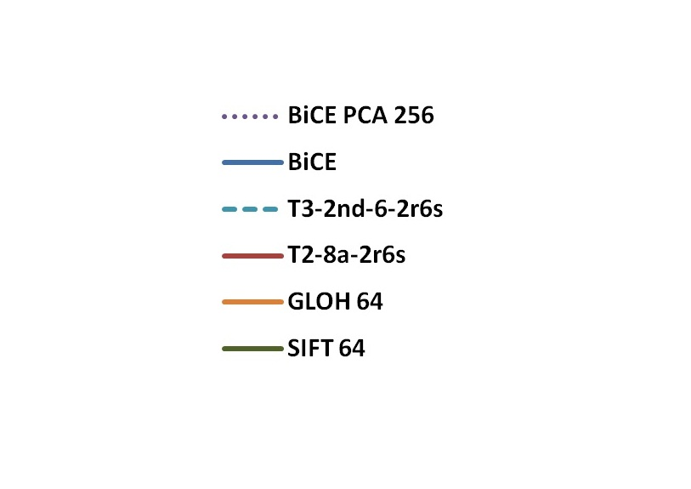
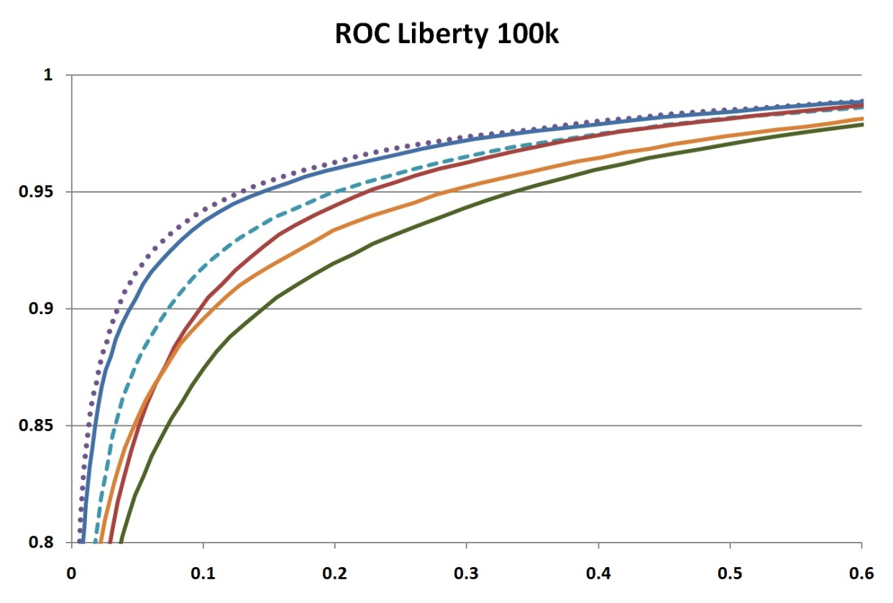
Some actual ROC curves

